Slide 1
AUTOSAR 4.2.1 MCAL
Changes between ASR4.0 and ASR4.2
NXP MCAL team

Slide 2
AUTOSAR 4.2.1 changes IMPACTING MCAL

Slide 3
AUTOSAR MCAL: Differences Between ASR4.0 and ASR4.2
Global Changes
Component | ASR 4.0.3 | ASR4.2.1
Configuration | Multiple Configuration Container for PB configuration | Variant Handling Approach *)
Memory Mapping | Single Memory Mapping file (MemMap.h) for all BSW modules | Separate Memory Mapping File per BSW module (<MSN>_MemMap.h)
Error Management | DEM Errors DET = Development Error Tracer - Development Errors | Extended DEM Errors DEM Errors DET = Default Error Tracer - Development Errors - Runtime Errors - Transient Fault Errors
Ecu Degradation | N/A | New concept

Slide 4
Variant Handling
The goal is to support application software suppliers to deliver one ECU software for several ECUs sharing the same application, but having different configuration of BSW using Variant Handling approach (several configuration sets exist in one ECU and the right one is chosen at start-up) and also to support OEMs to change (update) the BSW configuration of any of these ECUs using PBL approach (download new set of selectable configuration sets)
This is done in Autosar 4.2.1 by clearly separating the PBS and PBL concepts, where PBS concept shall be described as Variation Point Handling in post-build binding time and PBL concept shall be described as ECU configuration in configuration phase post-build.
Post-build variant handling: Each variant represents a configuration set of a physical instance of an ECU which may coexist with other variants of the same ECU (using any of the other selectable configuration sets) in the same physical vehicle
Post-build configuration: Configuration that happens at post-build time. Post-build configuration data is located in a separate segment and can be loaded independently of the actual code
AUTOSAR Variant Handling mechanism is used to indicate which configuration parameters and containers belong to which configuration set. Therefore for this approach, Variant Handling support is needed in the entire tool-chain
Until AUTOSAR 4.2.1 pre-compile configuration contained only one configuration set and post build configuration contained support for configuring multiple configuration sets. In AUTOSAR 4.2.1 regardless of the chosen pre-compile time, link time or post-build time configuration of a BSW module, multiple configuration variants may exist in the same configuration which is indicated by different variation points i.e variation points are independent of the implementation configuration class that is selected at configuration time..

Slide 5
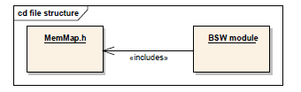

Memory Mapping: Differences Between ASR4.0 and ASR4.2
Autosar 4.0
{Mip} = <Msn>[_<vi>_<ai>] for basic software modules where:
<Msn> is the shortName
<vi> is the vendorId of the BSW module
<ai> is the vendorApiInfix of the BSW module
The sub part [_<vi>_<ai>] is omitted if no vendorApiInfix is
defined for the Basic Software Module.
Autosar 4.2.1

Slide 6
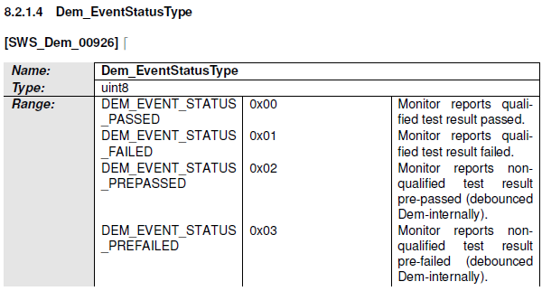
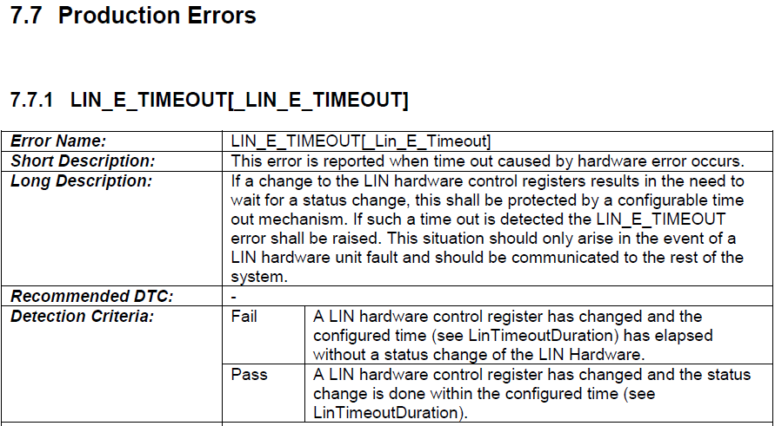
Error management
DEM errors must be reported throw the function Dem_ReportErrorStatus(EventId, EventStatus).
In ASR4.2.1, the call to DEM must be made also for FAILED and PASSED event:
The EventStatus parameter must be one
of the following:
Production Error example: LIN driver

Slide 7
ECU Degradation - Concept
Reduce energy consumption during IDLE task.
In CPU mode running, the energy consumption is independent of usage of CPU periphery and can be reduced by switching off periphery parts.
Even if a peripheral (like a timer or the ADC) is not used, the energy consumption will stay at 100% as long as that peripheral is active. So energy can be saved by setting the given peripheral to a low power state or disabling it.
PWM
On ---- Off
PWM
On ---- Off
(100-x)%
100%
Switch to Off
0% energy
100%
Switch to On
0% energy
100%
Switch to Off
0% energy
100%
Switch to On
0% energy

Slide 8
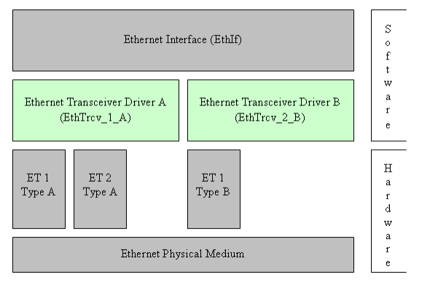
Ethernet Transceiver Driver - ETHTrcv
The PHY (EthTrcv) is the physical interface transceiver.
Ethernet MAC (ENET) it is connected seamless to commercial ethernet PHY (EthTRCV) devices via one of the following interfaces:
- a 4-bit Media Independent Interface (MII) operating at 2.5/25 MHz.
- a 4-bit non-standard MII-Lite (MII without the CRS and COL signals) operating at 2.5/25 MHz.
a 2-bit Reduced MII (RMII) operating at 50 MHz.
The Media Independent Interface (MII) is an Ethernet industry standard defined in IEEE 802.3. It consists of a data interface and a management interface between a MAC and a PHY
The data interface consists of a channel for the transmitter and a separate channel for the receiver. Each channel has its own clock, data, and control signals. The MII data interface requires a total of 16 signals. The management interface is a two-signal interface-one signal for clocking and the other for data. With the management interface, upper layers can monitor and control the PHY
NXP Ethernet Transceiver Stub contains two stub functions provided to be able to compile and link the Eth Module. These functions control the register of transceiver which convert Media Independent Interface (MII) signal to Ethernet signal. These stubs are hardware dependent (type of transceiver used on board). Each transceiver has sets of registers which control the hardware network as well as network mode.
To configure registers of transceiver, EthTrcv stub functions will use functions from Eth driver (ReadMii/WriteMii).
The relation between layers is:
EthTrcv -> EthIf -> Eth
The stub functions will be the notification which will indicate that the Read/Write to transceiver was successful

Slide 9
Communication Drivers: Differences Between ASR4.0 and ASR4.2
Communication Drivers
Component | ASR 4.0.3 | ASR4.2.1
CAN |  | CAN-FD Protocol Support Pretended Network Mode (No HW Support on Racerunner Ultra) Removed the feature related to canceling of pending TX messages with lower priority
ETH |  | New APIs to support Global Time Synchronization ** concept. (e.g. Eth_EnableEgressTimeStamp, Eth_GetEgressTimeStamp, Eth_GetIngressTimeStamp) New functionalities to manage statistic information according to IETF RFC2819 standard New APIs to manage the dropped packets based on some criteria.
FR |  | Buffer PDU management has been slightly changed: the config parameter FrBufferReconfig was split into three config parameters FrPrepareLPduSupport, FrReconfigLPduSupport and FrDisableLPduSupport
SPI |  | No notable changes
LIN |  | A new state is introduced (LIN_CH_SLEEP_PENDING) changing the management of sleep state (functions Lin_GoToSleep, Lin_GetStatus) A new API for wake-up mamangemnt has been introduced ("Lin_WakeupInternal“).
.
**) CONC_605_GlobalTimeSynchronization

Slide 10
Microcontroller and Memory Drivers : Differences Between ASR4.0 and ASR4.2
Microcontroller Drivers
Component | ASR 4.0.3 | ASR4.2.1
MCU |  | No notable changes
WDG |  | No notable changes
GPT |  | Predefined Free running Timer support.
Memory Drivers
Component | ASR 4.0.3 | ASR4.2.1
FLS |  | Added blank check functionality (e.g Fls_BlankCheck)
FEE |  | No notable changes.
.

Slide 11
I/O Drivers: Differences Between ASR4.0 and ASR4.2
I/O Drivers
Component | ASR 4.0.3 | ASR4.2.1
ADC |  | API and configuration parameter added to support ECU degradation concept ***
DIO |  | No notable changes
PORT |  | No notable changes
PWM |  | API and configuration parameter added to support ECU degradation concept ***. Two power modes will be supported FULL_POWER (all functionalities are enabled) and LOW_POWER (all functionalities are disabled and outputs are set to IDLE).
ICU |  | Removed ICU_ACTIVE_TIME for SIGNAL_MEASUREMENT mode
OCU |  | New module
.
***) CONC_ECUDegradation_596

Slide 12
Complex Device Drivers: Differences Between ASR4.0 and ASR4.2
Complex Device Drivers
Component | ASR 4.0.3 | ASR4.2.1
MCL (Microcontroller Library) |  | Support for Crossbar Switch configuration
MCEM (Microcontroller Error Manager) |  | No notable changes
.
***) CONC_ECUDegradation_596

Slide 13
NXP MCAL: Implementation and configuration details

Slide 14
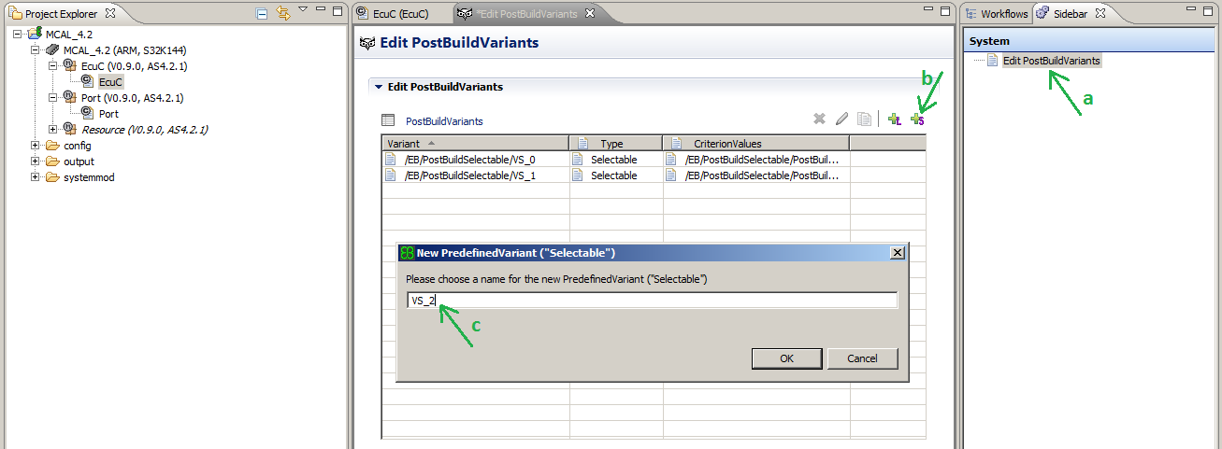
Creating the Predefined Variants using Elektrobit Tresos tool
In the Sidebar window on the right side, double-click the ‘Edit PostBuildVariants’. A new configuration window will open
Click on the rightmost + button to add a new Post Build Selectable item to the project configuration
Enter the name of the configuration and repeat steps b – c for how many configurations are needed for the project
Save the Project and close the ‘Edit PostBuildVariants’ window.

Slide 15
Ecu Configuration
ECU Configuration is one activity performed during the development of an AUTOSAR ECU
The activity of ECU configuration is to provide configuration information for all the software within one ECU
It shall be possible to have variation points in the ECU configuration which are bound at post-build time. This will allow the existence of several ECU configuration variants in one ECU

Slide 16
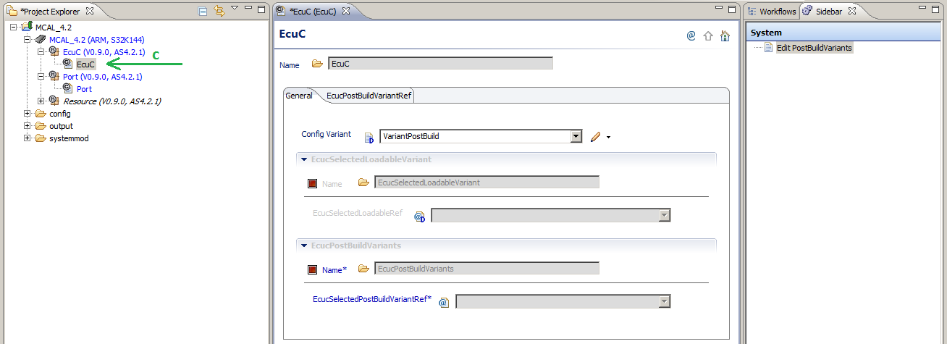
EcuC - Configuration using Elektrobit Tresos tool – Step 1
Make sure the EcuC plugin is copied in the ‘plugins’ folder of Tresos, along with the plugins of all other drivers to be used in the project
Open Tresos and create a new project, adding EcuC and other needed modules
Double-click the EcuC module in Project explorer. The configuration window will open and should look like below:

Slide 17
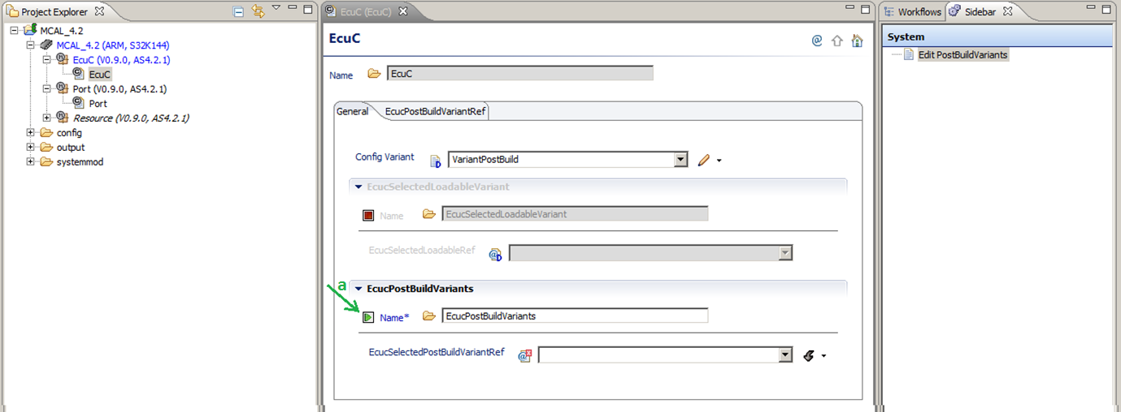
EcuC - Configuration using Elektrobit Tresos tool – Step 2
Enable the EcuCPostBuildVariants container

Slide 18
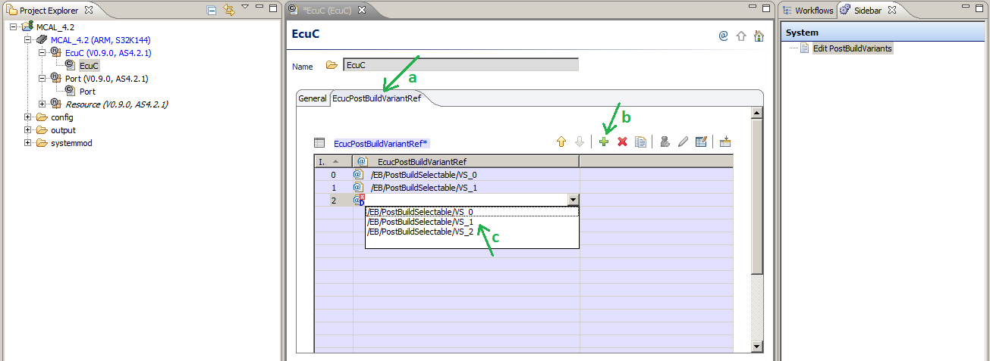
EcuC - Configuration using Elektrobit Tresos tool – Step 3
Click on EcucPostBuildVariantRef tab to select it.
Click on the + button to add a new PostBuild reference to EcuC module (from the Predefined Variant list)
Select one of the post build selectable items
Repeat step c for all needed post build variants needed. Save the project

Slide 19
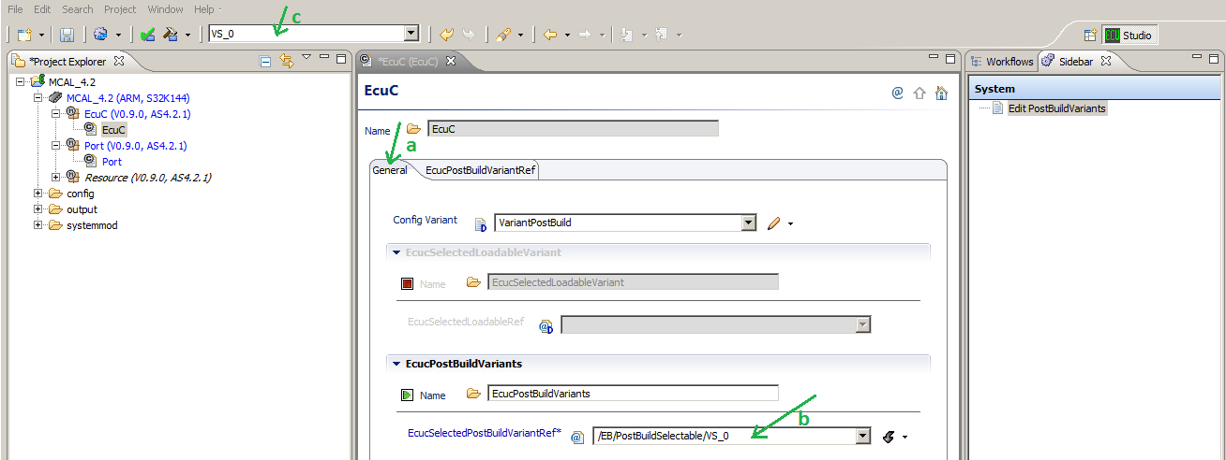
EcuC - Configuration using Elektrobit Tresos tool – Step 5
Click on General tab of the EcuC configuration window to select it
Select the current PostBuildSelectable variant used in the project from the ones defined in the previous steps
Selecting the current PostBuildSelectable variant to be used in the configuration of all modules in the project can be done also from the combo in the Toolbar of Tresos

Slide 20
Driver initialization - limitation
The general requirement for initialization is:
If the parameter checking for the Initialization function is enabled (SWS_BSW_00049), the Configuration pointer argument shall be checked with the following conditions:
In the supportedConfigVariants VariantPreCompile and VariantLinkTime if only one configuration variant set is used, the initialization function does not need nor evaluate the passed argument. Thus the Configuration pointer shall have a NULL_PTR value.
In the supportedConfigVariant VariantPostBuild or if multiple configuration variant sets are used, the initialization function requires the passed argument. Thus the Configuration pointer shall be different from NULL_PTR
If these conditions are not satisfied, a Development error with type "Invalid configuration set selection" shall be reported to Development Error Tracer (Det)
For the current implementation MCAL drivers do not expect a NULL PTR for a pre compile configuration, due to a tool limitation in counting the number of variants.
Due to this limitation, even for only one configuration variant set used at PreCompile the initialization shall be done using an explicit Configuration Pointer

Slide 21
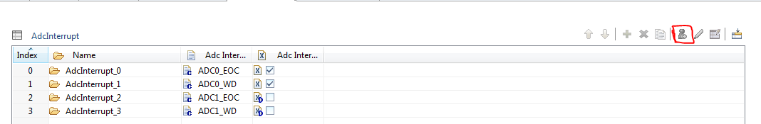
Configuration of interrupts handlers
PreCompile parameters shall not rely on user configured PostBuild parameters, because the content of variant aware configuration can change at PostBuild configuration time.
All Precompile parameters that can may be correlated with PostBuild parameters shall be explicitly configured by the integrator, populating some specific list (such as configuring the interrupts) in Tresos using a single click on Add required elements

Slide 22
Data structure split on files
File | ASR 4.0.3 | ASR4.2.1
<Mdl>_Cfg.h | Precompile parameters used in the driver, usually defines and constants, extern declarations and data types. | No significant changes regarding the content of this file.
<Mdl>_Cfg.c | Configuration structure for the driver used by <Mdl>_Init when called with NULL_PTR as parameter. When variant PreCompile is used, only one config set for the driver exists and it is generated in this file. This file is only needed in the PreCompile variant. | Static configuration structures containing only variables that are not variant aware, configured and generated only once. This file alone does not contain the whole structure needed by <Mdl>_Init function to configure the driver. Based on the number of variants configured in the EcuC, there can be more than one configuration structure for one module even for PreCompile variant.
<Mdl>_PBcfg_<Variant>.c | All configuration structures for PostBuild variant (based on the config sets from Tresos) are generated in <Mdl>_PBcfg.c. This file is only needed in the PostBuild variant. | There is one file for each variant. The name of the file contains the name of the variant, as defined in the EcuC. This file contains the configuration structure used by the driver that have variant aware members. Each file contains the configuration parameters for its corresponding variant. All parameters and/or structures that are not variant aware and were generated once in the <Mdl>_Cfg.c file are referenced in the structures from <Mdl>_PBcfg_<Variant>.c files if needed. The configuration structures are used in all variants.
<Mdl>_PBcfg_<Variant>.h | The file did not exist in the ASR 4.0.3 MCAL drivers. | It was created to export the extern declaration of each configuration structure, to be used when calling <Mdl>_Init in the application. There is one file for each variant. The name of the file contains the name of the variant, as defined in the EcuC.
<Mdl>_Lcfg.c | The content of the file is similar to the content of <Mdl>_Cfg.c, but it is used only for LinkTime. | The file was removed because the configuration structures are present in <Mdl>_PBcfg_<Variant>.c files.
.

Slide 23
ECU Degradation – Current solution: PWM
Since most of NXP timers capable of PWM the only why to support the LOW power modes is by disabling the timers without de-initializing the SW module. This is achieved by:
Setting PWM channels to IDLE state (from application)
Disabling the PWM counters and/or HW channels
The following APIs are made available to the user:
Pwm_PreparePowerState() → used to check if the requested targeted Power State can be achieved.
Pwm_GetTargetPowerState() → used to get the targeted power state of the timer module.
Pwm_GetCurrentPowerState() → used to get the current power state of the timer module.
Pwm_SetPowerState() → used to set the targeted state to timer module. In order for LOW power to be achieved, user application must set all PWM channels to IDLE state.
- Since disabling timer/counter can be achieved within few CPU cycles, , there is not need for a asynchronous power transition functionality. Thus: Pwm_Main_PowerTransitionManager() is implemented as an empty function.

Slide 24
ECU Degradation – Current solution: ADC
Since most of NXP AD converters can only support LOW power modes by disabling the HW unit without de-initializing the SW module. This is achieved by:
Setting ADC channels to IDLE state – no active conversion should be ongoing
Disabling the ADC clock source and/or HW channels
The following APIs are made available to the user:
Adc_PreparePowerState() → used to check if the requested targeted Power State can be achieved.
Adc_GetTargetPowerState() → used to get the targeted power state of the Adc module.
Adc_GetCurrentPowerState() → used to get the current power state of the Adc module.
Adc_SetPowerState() → used to set the targeted state to timer module. In order for LOW power to be achieved, user application must make sure that all ADC channels should not have ongoing conversions.
- Since disabling ADC clock can be achieved within few CPU cycles, there is not need for a asynchronous power transition functionality. Thus: Adc_Main_PowerTransitionManager() is implemented as an empty function.

Slide 25
ECU Degradation – Suggested call sequence

